Slide 1

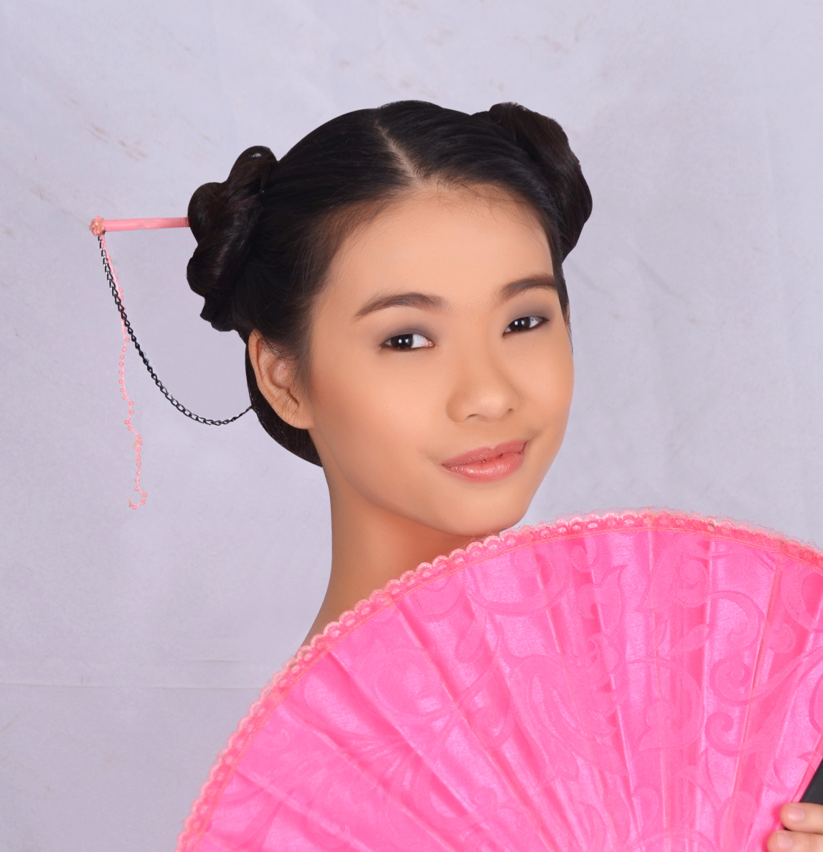



{
$$Hi! My name is Regine In and I’m$$
$a software developer from$
$the beautiful country$
$of Philippines!$
{
cute
^
{
$$Hi! My name is Regine In and I’m$$
$a software developer from$
$the beautiful country$
$of Philippines!$
{
cute
^

Slide 2


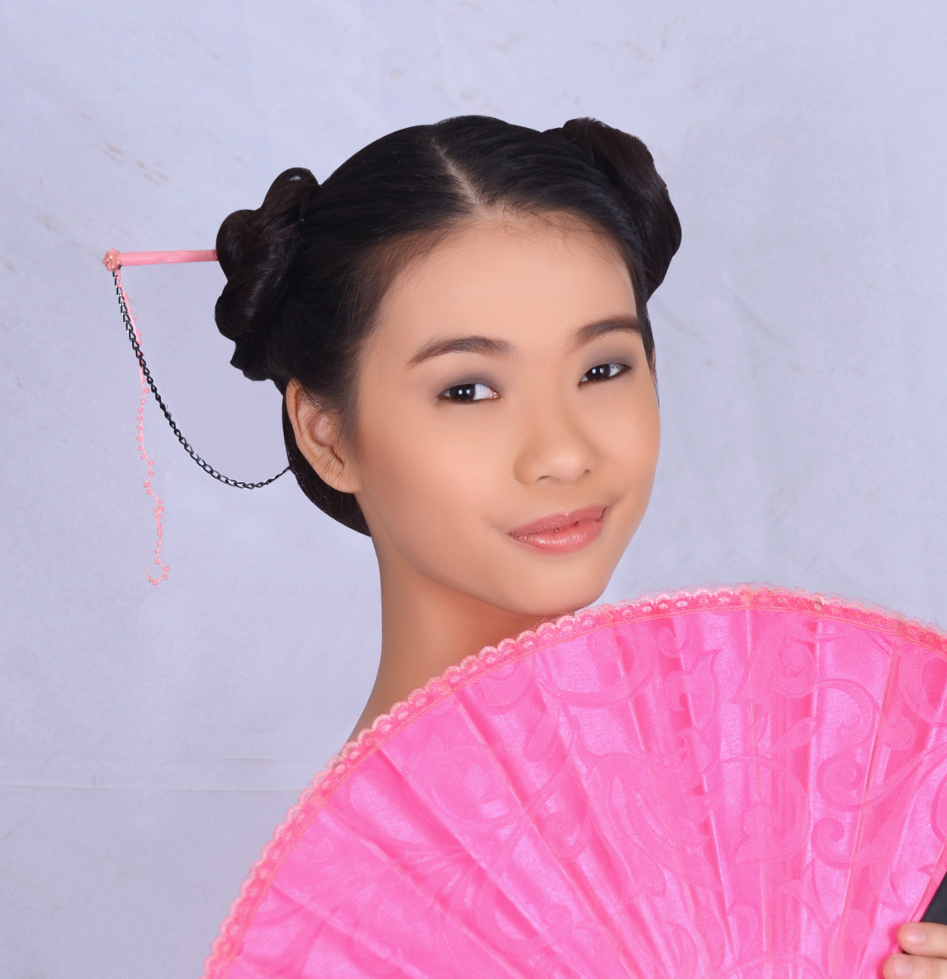




{
{
$$\text{Hi}\text{! }\text{My} \text{name} \text{is} \text{Regine} \text{In}$$
cute
$\text{and} \text{I}\text{’}\text{m}$ $\text{a} \text{software} \text{developer}$
^
$$\text{from} \text{the} \text{beautiful} \text{country}$$
$$\text{of} \text{Philippines}\text{!}$$

Slide 3





{
$$\text{Hi}\text{! }\text{My} \text{name} \text{is} \text{Regine} \text{In}$$
{
$\text{and} \text{I}\text{’}\text{m}$ $\text{a} \text{software} \text{developer}$
cute
^
$$\text{from} \text{the} \text{beautiful} \text{country}$$
$$\text{of} \text{Philippines}\text{!}$$

